Slide 1
Section 7.7 Circumcenter, Incenter, Orthocentre, and Centroid of a triangle

Slide 2
I) Intersection of Angle Bisectors [Incenter]
An angle bisector is a line that splits an angle in half
What happens when you draw all three angle bisectors of a triangle and connect them?
The intersection of all three angle bisectors will be the center of the inscribed circle
This point is known as the “Incenter”
The radius of this circle is perpendicular to each side of the triangle
Incenter

Slide 3
II) Perpendicular Bisectors of Each Side
A “perpendicular bisector” is a line that cuts a line in half and is perpendicular to it
When happens when your draw the “perpendicular bisectors” of each side
The intersection of all three perpendicular bisectors will be the center of a circle that circumscribes this triangle
This point is called the “Circumcenter”
The radius of this circumscribed circle will be the center to the vertices of the triangle
circumcenter

Slide 4
III) Medians of all three sides
A median is a line that connects a vertex to the midpoint of the opposite side
What happens when you draw the median of all three sides?
The intersection of all three medians is called the “centroid”
The centroid is the center of gravity of this circle
The distance of the centroid of any side is half the distance from the opposite vertex
Centroid

Slide 5
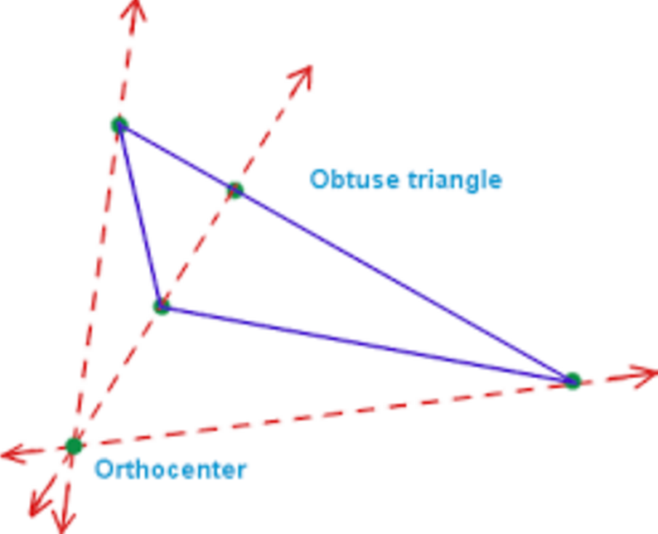
IV) Altitudes of all three sides
The altitude is perpendicular to one side and connects to the opposite vertex
What happens when you connect all three altitudes?
The intersection of all three altitudes is a point called the “orthocenter”
The orthocenter is useless
If the triangle is obtuse, then the orthocenter is outside of the circle
Orthocenter

Slide 6
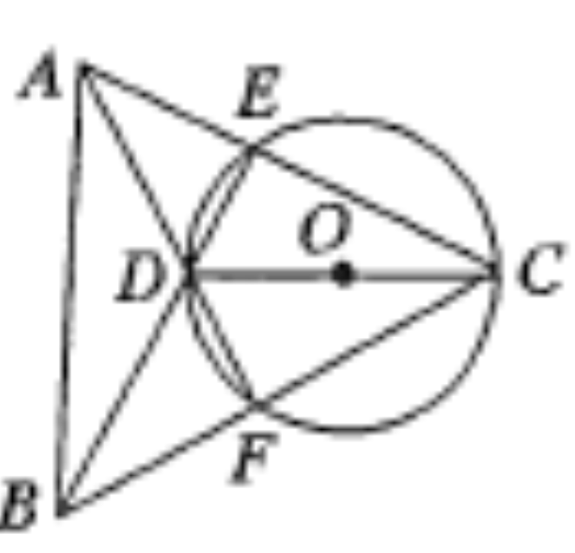
Challenge: In the diagram, CD is a diameter. Angle ECD is 50 degrees, angle EAD is also 25 degrees. What is angle DAB? Note(CEA and CFB are straight lines) (CNML)

Slide 7
AMC 12A 2011 #13
∆ AMN & ∆ ABC are similar triangles
Use trig. to get the area of ∆ABC
Draw the inscribed circle for ideas
Get the altitude from point A and the radius of the circle

Slide 8
Aime I) 2016
In triangle ABC, let “I” be the center of the inscribed circle, and let the bisector of angle ACB intersect AB at “L”. The line through “C” and “L” intersect the circumscribed circle of triangle ABC at two points “C” and “D”. If LI=2, and LD = 3, then IC=p/q, where “p” and “q” are relatively prime positive integers. Find the value of p+q:
Find all the similar triangles!

Slide 9
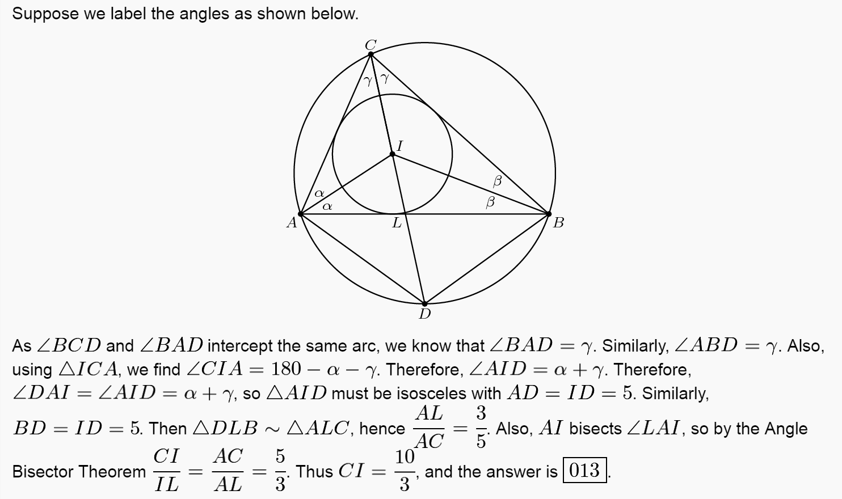

Slide 10
Amc 12a 2011

